Slide 1
BAbAtye Mobile app for barcode reader
ROSHAN DHITAL (30361962)
PRODUCT OWNER: Kamal Pun (30371365)
SCRUM MASTER: Riaz Qadir (30364968)
DESIGNER : Haque Mohammad (30379834)
TESTER: Singh Jashandeep (30362218)

Slide 2

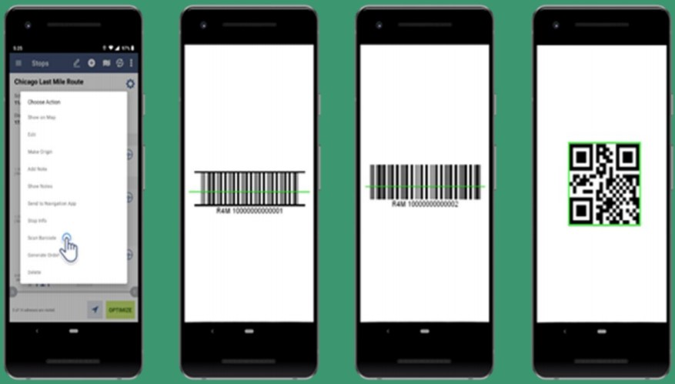
TABLE OF CONTENTS
Project Introduction
Team Formation
Client and Supervisor
Work Breakdown
Requirements (User Stories)
High Level Architecture
Sprint 1 and Sprint 2
Sprint Review
Activity Diagram
System Sequence Diagram
Use Case Diagram
ER Diagram Database
Sprint Burndown Chart
Phases in Project
Non-Functional Requirements
Software and Tools
Project Meetings
Retrospective Meeting Reflection
Client Feedback
Product Prototype Link

Slide 3
Project INTRODUCTION
Project for Babtye Clothing Store
Envisioned Solution: Working app and database
Mobile App for Barcode Reader
5 Members

Slide 4

Team formation and roles:
Stake holders | Represent | Roles
Roshan Dhital | Project Leader | Roshan is The project Leader.
Kamal Pun | Product Owner | Product owner has a responsibility for managing the requirements.
Riaz Qadir | Scrum Master | Riaz will be looking after the communications.
Jasshandeep Singh | Tester | Jashandeep is the team member.
Muhammad Haque | Designer | Muhammad will be designing the basics of the app.

Slide 5
Client and supervisor
Client
Rifat Sharmin
Manager of Babatye clothing store
Explained the project requirements.
Supervisor
Mr. Sunil Cooray
Offered feedbacks to the team work

Slide 6
WORK BREAKDOWN
Tasks | Client | Supervisor | Project Leader | Product Owner | Scrum master | Programmer | Designer
Assign project Leader |  | R |  | C | C | C | C
Assign Project Owner |  | R | R |  | C | C | C
Assign Scrum Master |  | R | R | C |  | C | C
Identify Stakeholders | C | C | R
Identify Main Tasks | I | C | R | A | C | C | C
Work Breakdown Structure | I | I | R | A | C | C | C
Keeping Track with Deadlines | I | C | R | A | C | C | C
Communication Management |  |  | A | C | R | C | C
Risk Management |  | I | C | R | C | A | C
Quality of work | C | C | R | C | C | A | A
Keeping track of team members | I | C | R | A | C | C | C

Slide 7


Requirements
Requirement | Condition of satisfaction | Priority
US1 As a user, I want to create an account so that I can start using scanner app. | Login credentials created. | Medium
US2 As a user, I want to login so that I can start using app to scan barcode of cloths to save time. | Successful login and user can use the app to scan barcodes straightway. | High
US3 As a user, I want the app to show user details so that I can review time and details of employee scanning the cloths. | Interface showing details of employee scanning items with time. | Low
US4 As a user, I want scanned barcode data to be stored directly into data repository so that I can organise all information. | Scanned data from barcode is stored into data repository. | Critical
US5 As a user, I want to store each data in barcode in individual columns into the database so that I can retrieve information individually. | Database has individual columns for different data included in barcode. | Critical
US6 As a user, I want to retrieve information according to category, type, weight, size, and colour of the product so that I can track and manage stock in inventory. | Database shows product accordingly and items left in stock. | High

Slide 8
Requirements
App that scans barcode and save time
Able to store data in the repository
Information retrievable such as product type, category, colour etc
Simplicity of an app and user friendly tools.
Flexible to any OS.

Slide 9
Requirements CONT...
US7 As a user, I want to retrieve details of employees and suppliers so that I can process returns and correct missed supplies. | Database shows employees and supplier details. | Medium
US8 As a user, I want the system to be flexible so that any additional data included in the barcode may be retrieved. | Database should include new information included in barcode such as material. | High
US9 As a user, I want each item to have unique identifier (UID) in database so that it can be searched easily and quickly with that identifier. | All information stored in database have unique identifier and can be searched. | Low
US10 As a user, I want the app to be universal so that it can work on any normal mobile irrespective of OS. | App works on any normal mobile. | Critical
US11 As a user, I want to manually update information in case app is unable to scan barcode or there is no barcode attached so that I can store the items information in database as damaged. | User can update information manually. | Medium
US12 As a user, I want to scan all types of barcodes so that any items from different suppliers using different barcodes can be scanned. | App can scan all types of barcodes like Universal barcodes, QR codes and so on. | Critical

Slide 10
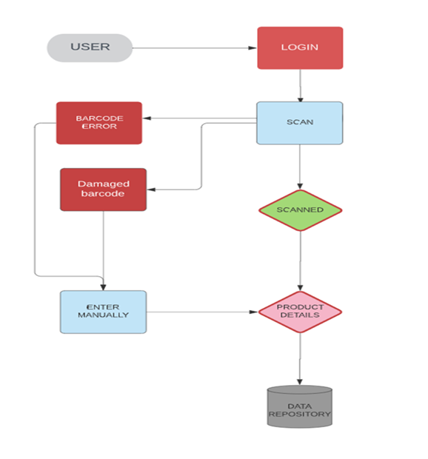
HIGH-LEVEL ARCHITECTURE

Slide 11

Sprint 1
Theme: Create registered user for app
Wishlist: To create prototype user interface
SPRINT 2
Theme: Create data repository
Wishlist: To create Sample Database

Slide 12
Sprint documentation targets for:
Exciting scope of work
Excellent team work
Excellent project processes
Tools that work and enhance the project
Sufficient resources
Satisfied Client

Slide 13
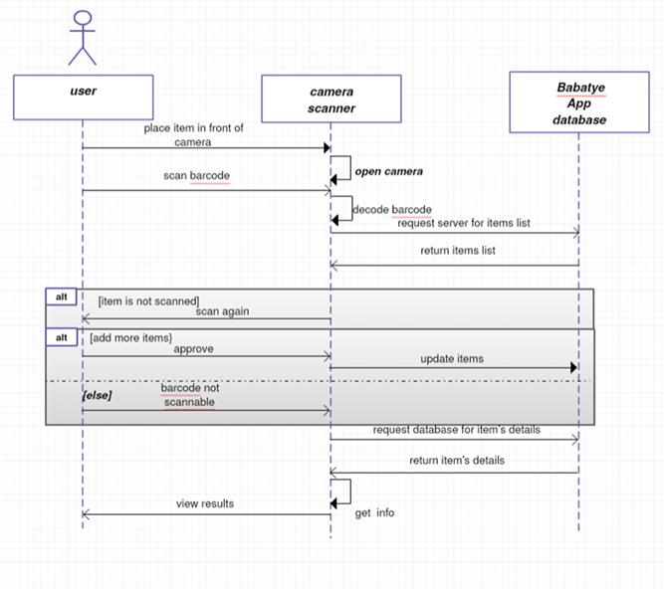
System sequence diagram

Slide 14
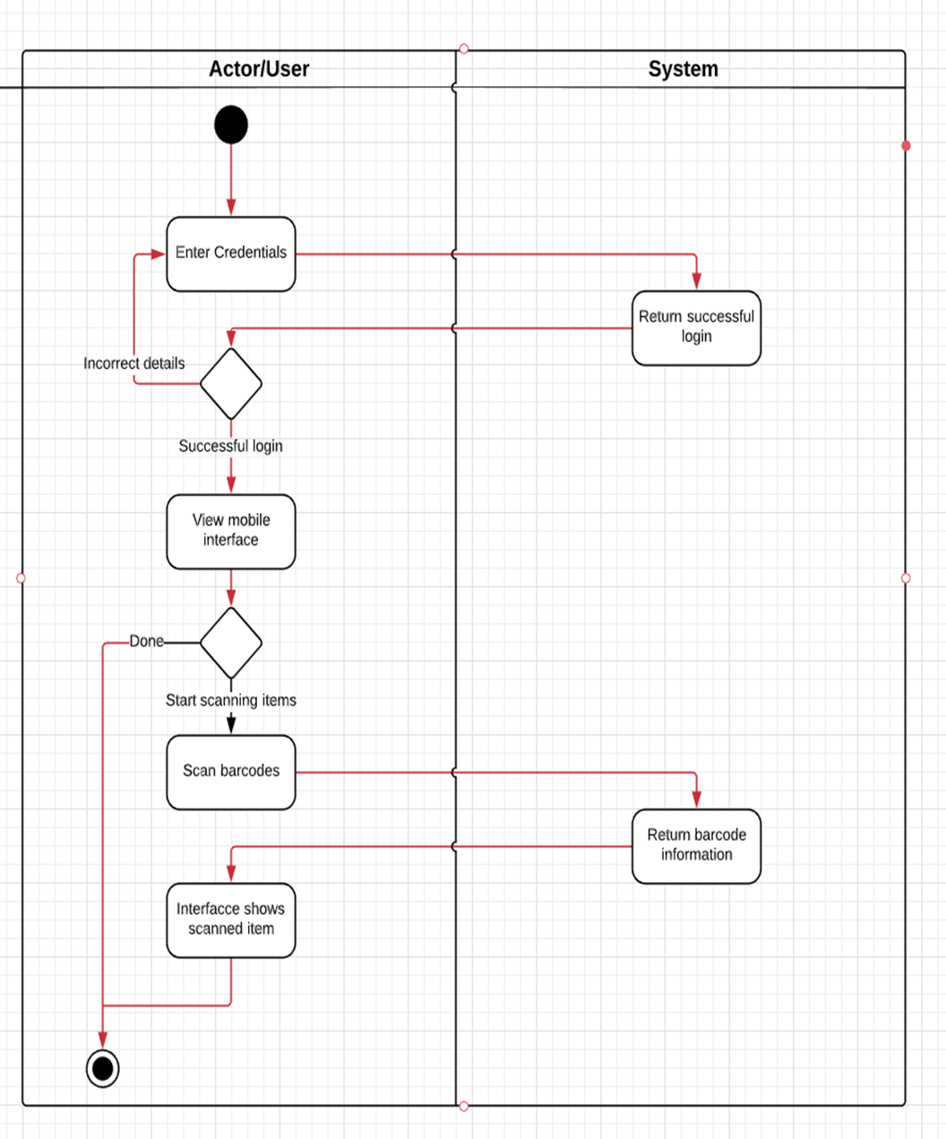
Activity Diagram
1

Slide 15
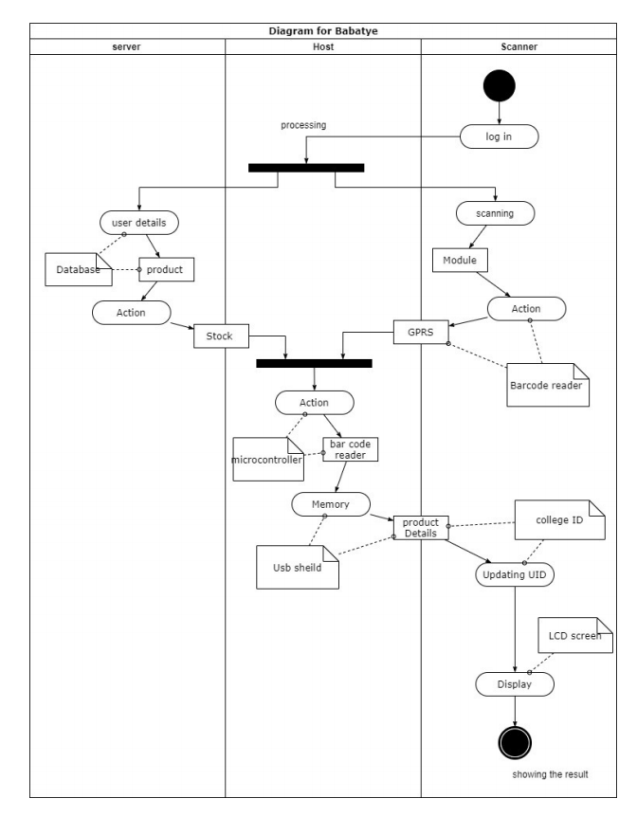
Activity Diagram
2

Slide 16
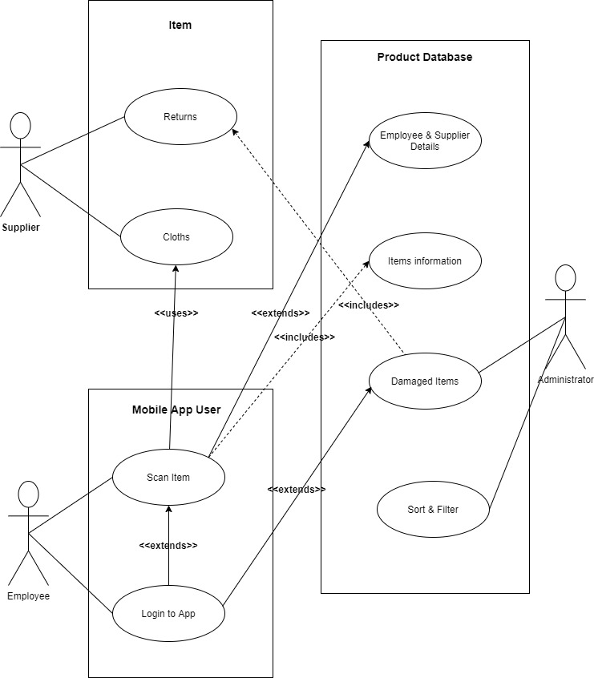
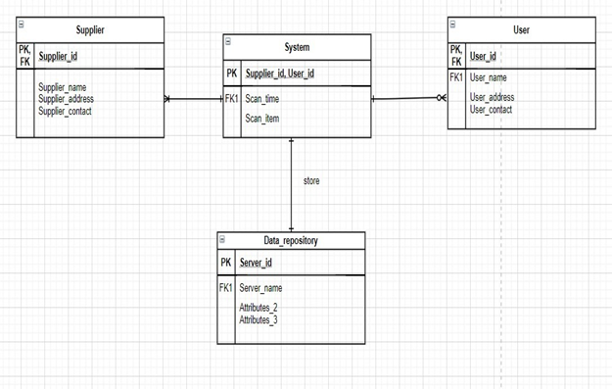
USE CASE & ER diagram

Slide 17
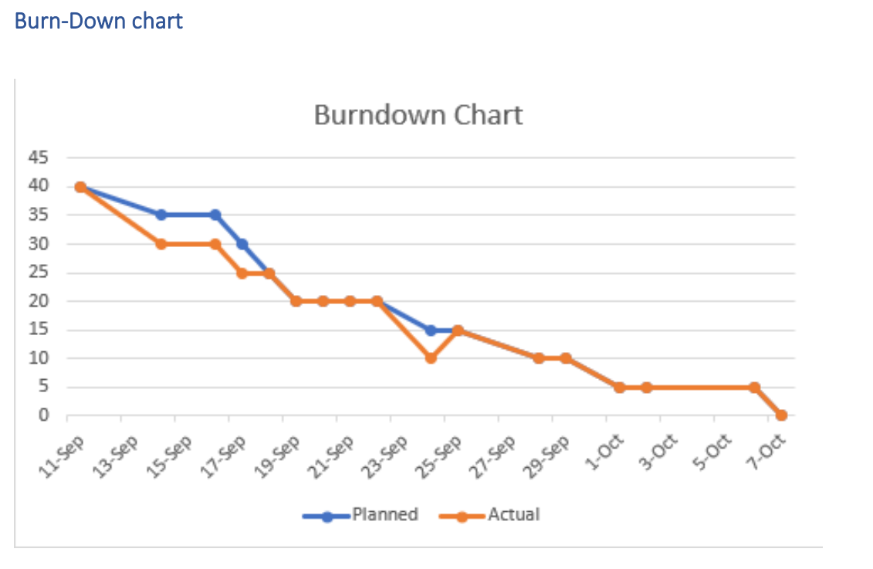

Slide 18
Non-Functional requirements
Platform
INVISION FOR PROTOTYPE
Communication
APP Communicates with data repository
Performance
Smooth performance due to simplicity of app
Security
Need to signup/login for an access
Audience
Supplier teams of a store

Slide 19
Non-Functional Req Cont.
Reliability
No defects in scanning and retrieving information
Modifiability
Additional bugs can be fixed easily
Economic
Data repository and maintenance of app may cost

Slide 20

Software and Tools
Invision
Github
Lucid Chart
Zoom
Ms Teams
SOTWARE AND TOOLS

Slide 21
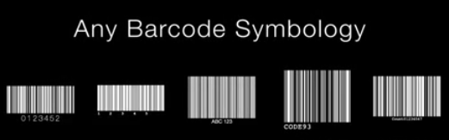
representation of functionalities
Multitasking
do multiple scans in one code
Any angle
scan at any angle 360 degree
Code Brightness
scan in low lights
Scanability
scan any damaged, glazed, tiny barcode, curved, low contrast barcodes

Slide 22
PROJECT MEETINGS
Client meeting
Team meeting
Supervisor meeting
To understand the requirements and make changes
To get feedbacks on the group task for better results.
To divide tasks and accomplish goals.

Slide 23
Retrospective meeting
Item 1: What went well?
Good Participation
Equal work distribuion
Item 2: What could be improved?
More stand-up meeting
Review and monitor of tasks
Clear understanding
Positive feedback
Outcomes
Research

Slide 24
Retrospective meeting CONT...
Item 3: What can we do?
Team cooperation
Item 4: What is not in our control?
Connectivity
Time management
Brainstorm outcomes
Reasonable work distribution
Stick to deadlines
Client satisfaction
Different time availability of group

Slide 25

feedback
Both the client and supervisor were impressed with the project work and they offered some positive feedbacks on our work.
Client:
Recommendation on manual input of barcode
Recommendation on having login credentials only for supplier teams
Supervisor:
Feedback on each part of our project work
Recommendation on making tasks concise and clear.

Slide 26
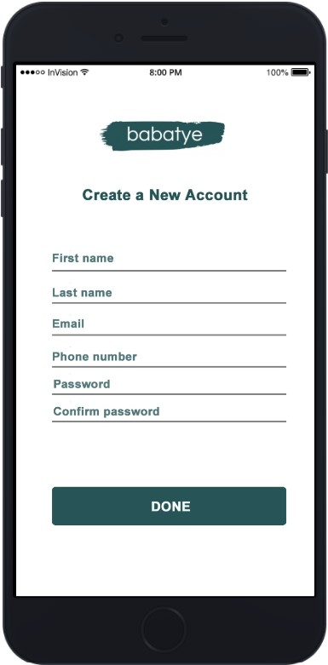
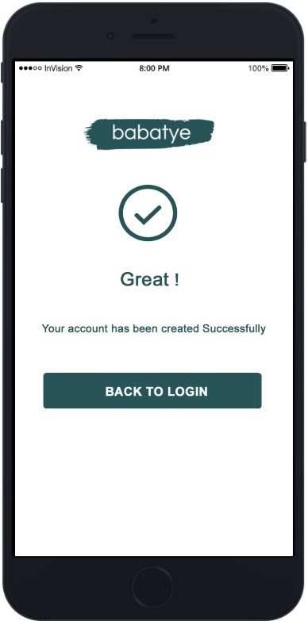
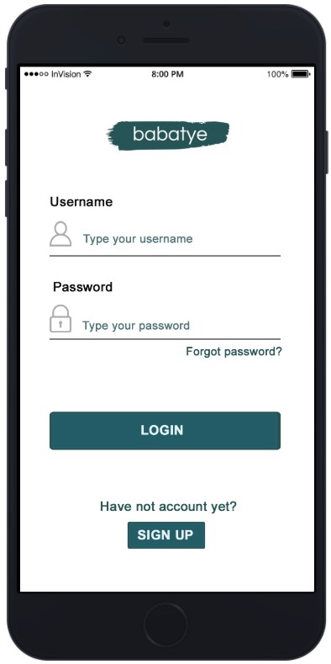
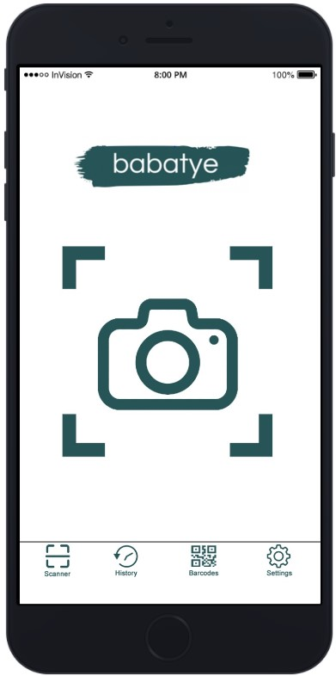
Interface design
Create account Successful signup Login page Scan Interface
Page Page

Slide 27
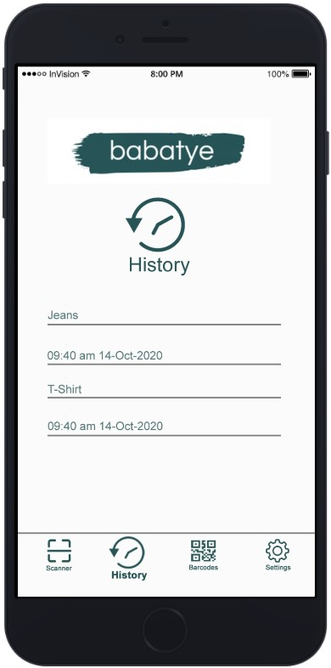
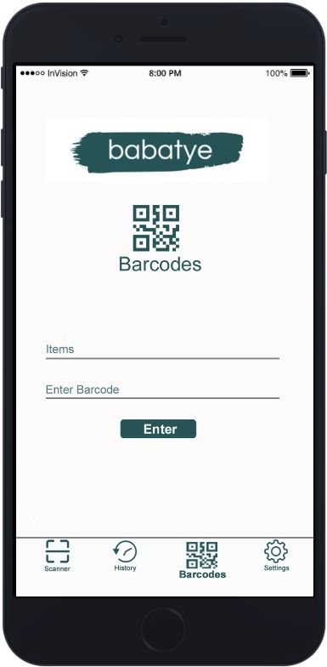
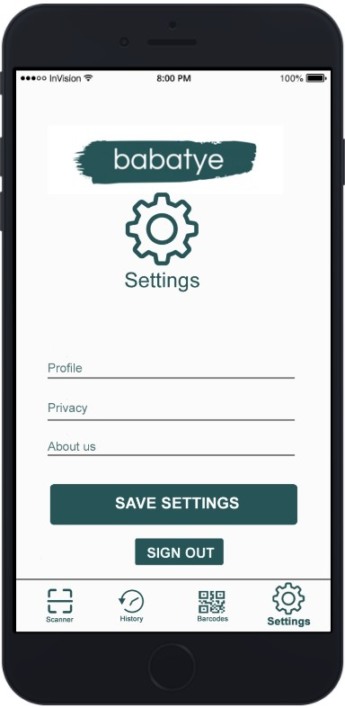
Interface design Cont.
History page Manual code input Settings page
page

Slide 28

“Product Prototype link”
https://invis.io/83Z316MHG9C

